Slide 1
2023 NFHS Track and Field and cross country powerpoint
Rules Changes
Major Editorial Changes
Points of Emphasis

Slide 2

National Federation of
State High School Associations
NFHS (located in Indianapolis, IN – Est. 1920):
  National leader and advocate for
  high school athletics and
  performing arts programs.
  Serves 51 state associations, 19,500
  high schools and 12 million student
  participants.
  Writes playing rules for 17 high school
  sports for boys and girls.
  Offers online education courses for high school coaches,
  officials, parents, students and others.
  Ensures that students have opportunity to enjoy healthy participation, achievement and good sportsmanship in education-based athletics.
Notes:
The NFHS is the national leadership organization for high school sports and fine arts activities;
We serve as the National authority on interscholastic sports and activities; conduct national meetings; sanction interstate events; produce national publication for high school administrators;
National source for interscholastic coach training and national information center.
VISION - It is the vision of the NFHS to help prepare tomorrow’s leaders for the next level of life through the many program offerings in education-based athletics and activities.
The National Federation of State High School Associations (NFHS) is the national leader for education-based high school athletics and activities,
which prepare tomorrow’s leaders for the next level of life through innovative programs, healthy participation, achievement, and development of positive relationships.
MISSION - A significant responsibility of the NFHS is the commitment to writing quality playing rules.
The National Federation of State High School Associations (NFHS) serves its members by providing leadership for the administration of education-based high school athletics and activities
through the writing of playing rules that emphasize health and safety, educational programs that develop leaders, and administrative support to increase participation opportunities and promote sportsmanship.
NFHS Membership includes 50-member state associations plus the District of Columbia.
Our membership is split into 8 different sections which are depicted in this map you see here.
The NFHS reaches more almost 20,000 high schools and 12 million participants throughout the 8 NFHS sections across the U.S.

Slide 3

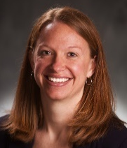
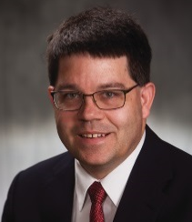


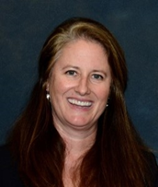
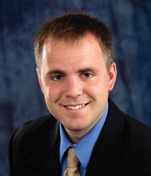
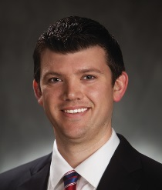
NFHS Rules Review Committee
The NFHS Rules Review Committee is chaired by the chief operating officer and composed of all rules editors. After each committee concludes its deliberations and has adopted its recommended changes for the subsequent year, such revisions will be evaluated by the Rules Review Committee.
Davis Whitfield
Chief Operating Officer
Lindsey Atkinson
Basketball, Girls Lacrosse and Volleyball
Bob Colgate
Football and Sports
Medicine
Sandy Searcy
Softball, Swimming & Diving and Water Polo
Elliot Hopkins
Baseball and Wrestling
Julie Cochran
Cross Country, Gymnastics, Field Hockey, Soccer and
Track & Field
James Weaver
Boys Lacrosse
and Spirit
Dan Schuster
Ice Hockey

Slide 4
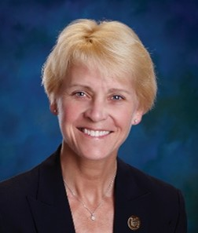

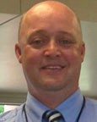
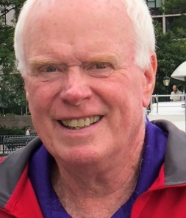

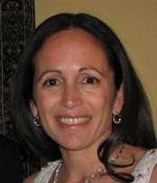

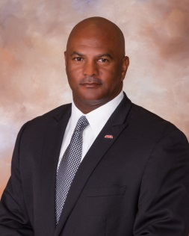
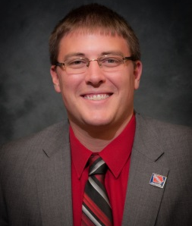
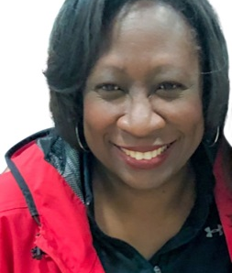
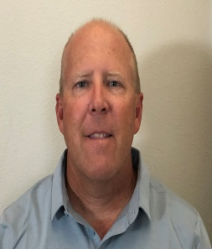
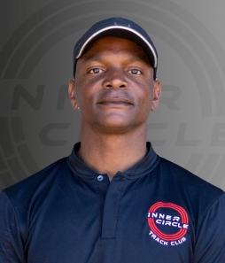
NFHS Track and field Rules Committee
Dr. Karissa Niehoff
NFHS
Publisher
Julie Cochran
NFHS
Editor
Cody Inglis
East Lansing, MI
Chair - 2023
Dan Doherty
Pearly River, NY
Coaches - 2022
Thomas McTaggart
Sloatsburg, NY
Officials - 2024
Yvonne Grimes
Sandy Hook, CT
Section 1 - 2024
Tia Clemmons
Upper Marlboro, MD
Section 2 - 2025
Alvin Briggs
Montgomery, AL
Section 3 - 2022
Jared Chizek
Boone, IA
Section 4 - 2023
Roberta McWoods
St. Louis, MO
Section 5 - 2024
Mike Whaley
Oklahoma City, OK
Section 6 - 2023
Brian Weaver
Clovis, CA
Section 7 - 2025
Hashim Hall
Tigard, OR
Section 8 - 2026

Slide 5




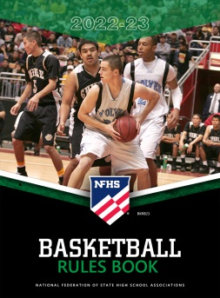









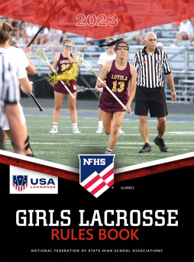



National Federation of
State High School Associations
The NFHS writes playing rules for 17 sports
for boys and girls at the high school level.
  Publishes 4 million pieces of materials annually.
Notes:
The NFHS writes rules for 17 sports, publishes High School Today along with several other key publications totaling over 4 million pieces annually.

Slide 6

NEW NFHS Rules App
Rules App features:
  Searchable
  Highlight notes
  Bookmarks
  Quizzes for all sports
  Easy navigation
  Immediate availability
  Free to paid members of the NFHS Coaches
  and Officials Associations
  www.nfhs.org/erules for more information

Slide 7
2023 nfhs track and field RULES CHANGES

Slide 8
Rule 3-4-3 and 5-9-2
Guidelines were added to the rules book on when and how to determine a rerun.
ART. 3 . . . The referee has the sole authority to determine if a race shall be rerun, and if so, who is eligible to participate in the rerun and when it should be
scheduled.
NOTE: Refer to NFHS Rules 5-9-2 and 5-9-3 for interference guidelines.
a. Determine if a rerun is necessary:
1. Acknowledge that a race rerun will rarely, if ever, be fair to everyone and should be avoided if at all possible.
2. To consider a rerun, one of the following must apply:
(a) interference by another competitor resulting in disqualification;
(b) interference caused by a nonparticipant; or
(c) a meet administration error, i.e., wrong staggers, hurdle setting, official's instructions, etc.
3. Reruns should be considered only in races or relays with individual legs of 400 meters or less for a one-day meet. A competitor who is eligible and elects to participate in the rerun wipes out any performance, including place, time or record, in the original race.
4. Any disqualification that occurred in the original race would stand.
The following was added to Rule 5-9 with this addition.
ART. 2 . . . If interference occurs in a preliminary heat, the referee may allow the offended competitor or relay team to start in a subsequent heat in the same round of heats if a lane is available. If a lane is not available, the meet referee may add a heat in that round or in the next round of heats, the same as if the offended competitor or relay team had won a place.
Notes:
Rationale: Defined specific guidelines from the case book to offer consistency and guidance to a meet referee when ruling on reruns.
By adding this to the rules book a tweak to rule 5-9-2 was also added by the rules committee. Key takeaways plus the language in the book was added to the slide.

Slide 9
4-2-2
SECTION 2 PARTICIPATION AND ENTRY LIMITATIONS
ART. 1 . . . A competitor shall not compete in more than four events, including relays.
Contestants may officially participate in: Contestant may officially enter:
PENALTY: A competitor who participates in more events than allowed by rule shall forfeit all individual places and points and shall be disqualified from further competition in that meet. In a relay event, the team's relay points, and place(s) shall also be forfeited.
ART. 2 . . . A contestant shall not be entered in more than four events, excluding relays. If a contestant is entered in more than the allowable number of events, meet management shall scratch the contestant from the excess event(s) by following the listed order of events.
ART. 3 . . . These entry and participation limitations do not apply to multi-event competition.
Athlete Participates in: | Athlete is permitted to participate in:
Four individual events | No relays allowed.
Three individual events | May be listed on any number of relays but compete in only one relay.
Two individual events | May be listed on any number of relays but compete in only two relays.
One individual event | May be listed on any number of relays but compete in only three relays.
Zero individual events | May be listed on four relays and may compete in four relays.
Notes:
Rationale: The athlete is not disqualified from an event until they participate in more than four events. The table was revised and moved to clarify the number of events an athlete may participate during a meet.

Slide 10
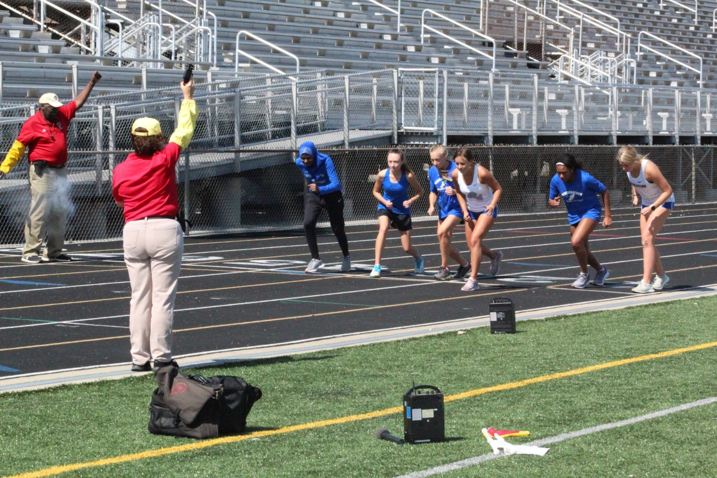
5-7-2
To standardize the starter hold times the following language was added
The interval between the set command and the firing of the starting device is approximately two seconds.
Notes:
Rationale: Standardize starter hold times for fair and consistent starts.

Slide 11
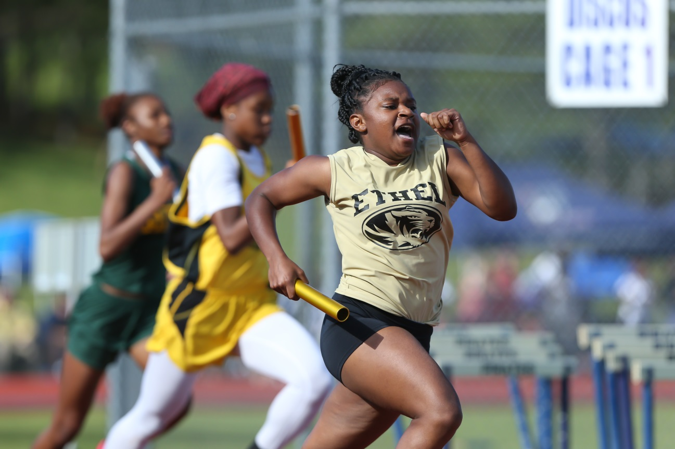
5-10-2
Providing two additional names to the relay entries should provide more flexibility to a coach when setting their roster and for more athletes to be involved in regular and post season track meets.
SECTION 10 RELAYS
ART. 2 . . . In relay events, no more than eight individuals may be listed on the relay entry, but only those who actually run will be considered official participants. Any substitutions must come from those names on the relay entry.
Note: It is not necessary to use the same four competitors in the finals who competed in the preliminary rounds of trials.
Notes:
Rationale: Providing two additional names gives opportunity for more athletes to be involved in regular and postseason track meets.

Slide 12
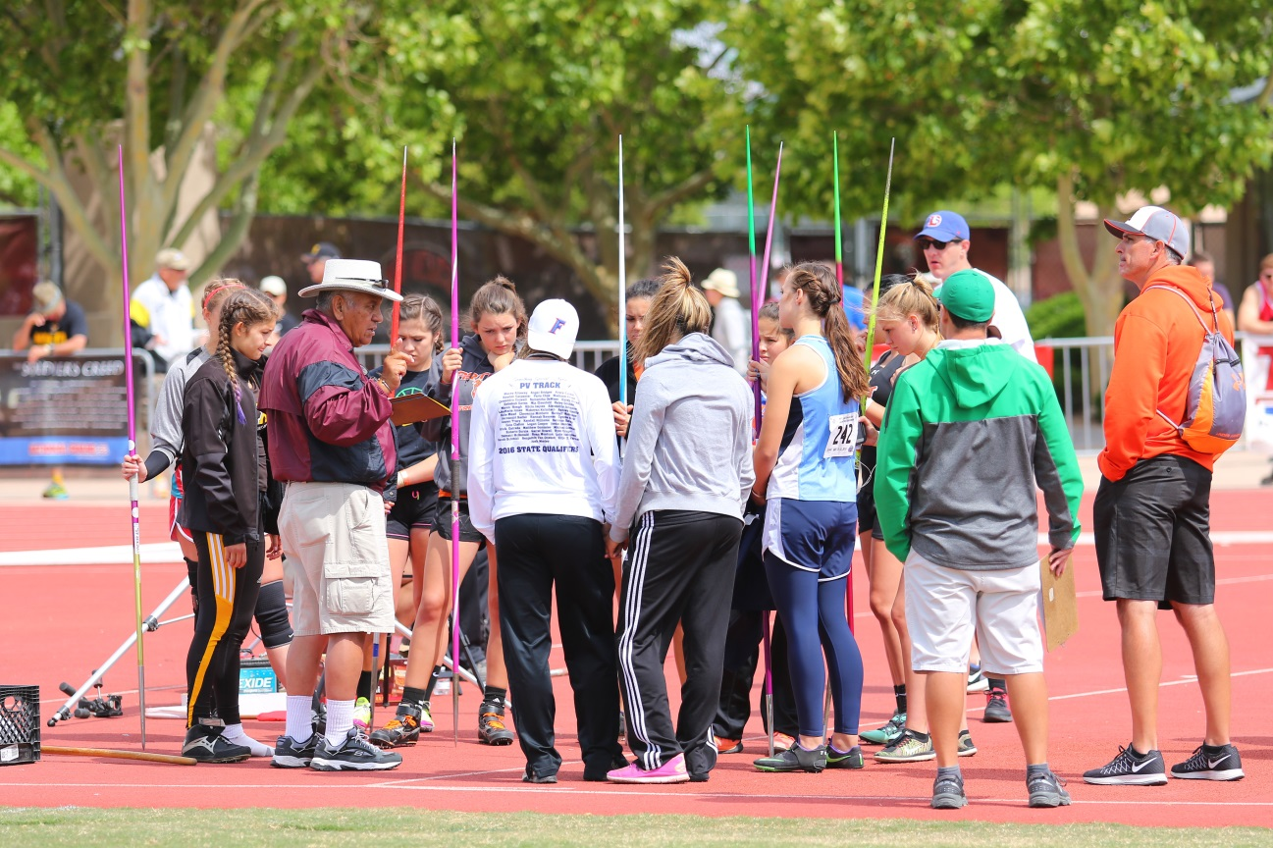
6-6-4
SECTION 6 JAVELIN THROW
ART. 4 . . . The first point of contact shall be within the sector made by extending radii of the foul-line arc through the intersection of the arc with the runway lines.
Notes:
Rationale:
Rule 6-6-7 states that the measurements in javelin shall be from the nearest edge of the first point of contact made by the javelin. This language was added to 6-6-4 for consistency and clarification.
If the first point of contact is not within the sector line then this is a foul.

Slide 13
7-2-2g (NEW)
SECTION 2 SPECIAL EVENTS
ART. 1 . . . The following may be included in the order of events and shall be conducted under USATF youth event rules unless state association policy determines otherwise (www.usatf.org/about/competition-rules.aspx):
a. Shuttle relays
b. Specialty relays
c. Steeplechase
d. Hammer throw
e. Race walking
f. Indoor weight throw (using legal weight throw cage)
g. Mixed Relays
Notes:
Rationale: Mixed relays are becoming more popular at high school meets adding them to special events offers guidance to the states on how to conduct these events.
Teams should follow USATF youth event rules for the event unless state association policy determines otherwise.

Slide 14
Rule 9 (new) indoor track and field
Indoor track and field will still follow Rules 2 thru 6 within the rules book.
This section will identify items specifically relating to indoor track and field for convenient reference.
It is understood that all high school indoor facilities are not uniform. Adaptations due to track size and field event availability may be made in order to conduct a meet fairly and efficiently.
Notes:
Rationale: There are 17 states that conduct state championships in indoor track and field, over 150,000 participants, and 21 states that sanction the activity. With recent changes to the outdoor track and field rules it became clearer that it was necessary to create a section specifically to indoor track and field rules.

Slide 15
10-3-2b
Old rule 9 Records is now Rule 10
SECTION 3 FIELD EVENTS
ART. 2 . . . In the vertical jumping events:
a. a competitor shall be credited with their best achievement, including performances made in the jump-off of a first place tie;
b. an accurate measurement of the height of the crossbar shall be taken before each record attempt. Mark the crossbar and base of the standards to ensure consistent placement of the crossbar. Any displaced or jostled crossbar should be placed on the standards in exactly the same position as before its displacement. and
c. the crossbar height shall also be measured if the bar has been touched by a competitor before another competitor also jumping at the record height proceeds.
This was also amended in 6-8-12 and 6-8-28 Vertical Jumps
SECTION 8 VERTICAL JUMPS
Notes:
Rationale: Adding the words ‘or jostled’ clarifies the intent of the 2022 rules change.

Slide 16
2023 NFHS track and field editorial changes

Slide 17
Rule 5-1-1
RULE 5 RUNNING EVENTS
NOTE: For more detailed information regarding track construction, contact American Sport Builders Association (ASBA), 8480 Baltimore National Pike, #307, Ellicott City, MD 21043, 410-730-9595, info@sportsbuilders.org, www.sportsbuilders.org. The American Sports Builders Association Construction and Maintenance Manual is available as a resource for technical information on construction.
ART. 1 . . . A 400-meter track is standard. It has two straight sides and two curved ends. The length of the track and the radius of the curve is often influenced by the available space. The length of the track should be at least 400-meters and not more than 400.08-meters. The radius of tracks may differ, depending on the configuration for activities inside the oval.
NOTE: Tracks constructed after January 2024 shall be at least 400-meters and not more than 400.08 meters.
Notes:
Adding more definition to the track size will protect schools when dealing with contractors and making sure 400m track facilities are the right size.

Slide 18
2023 nfhs track and field points of emphasis

Slide 19
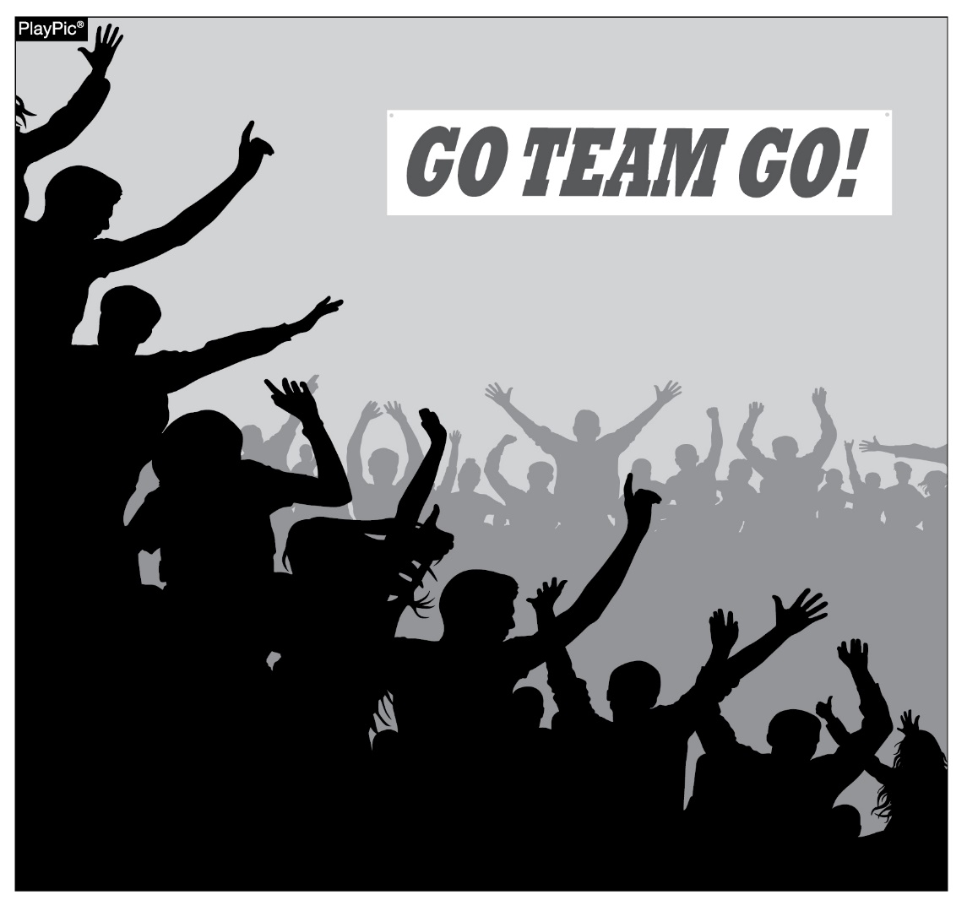
sportsmanship
NFHS playing rules are written to encourage sportsmanship. Participation in these programs should promote respect, integrity and sportsmanship. However, for these ideals to occur, everyone involved in these programs must be doing their part.
Notes:
NFHS playing rules are written to encourage sportsmanship. Participation in these programs should promote respect, integrity and sportsmanship. However, for these ideals to occur, everyone involved in these programs must be doing their part.
Sportsmanship, or good sporting behavior, is about treating one another with respect and exhibiting appropriate behavior. It is about being fair, honest and caring. When these types of appropriate behavior occur, competitive play is more enjoyable for everyone.

Slide 20
sportsmanship
The NFHS is concerned that unsporting behavior in education-based athletic has increased across all sports. As a result, the NFHS has made sportsmanship the no. 1 Point of Emphasis for the 2022-23 school year.
The interscholastic coach is responsible for setting the tone at athletic contests and must act in a sportsmanlike manner.
If coaches are complaining constantly about the decision of contest officials, spectators are likely to do the same.
A positive, open line of communication between officials and coaches ultimately leads to better behavior by student-athletes.
Good sporting behavior is expected before, during and after every contest.
Notes:
The NFHS is concerned that unsporting behavior in education-based athletic has increased across all sports. As a result, the NFHS has made sportsmanship the no. 1 Point of Emphasis for the 2022-23 school year.
The interscholastic coach is responsible for setting the tone at athletic contests and must act in a sportsmanlike manner.
If coaches are complaining constantly about the decision of officials, spectators are likely to do the same.
A positive, open line of communication between officials and coaches ultimately leads to better behavior by student-athletes.
Good sporting behavior is expected before, during and after every contest.

Slide 21
sportsmanship
Contest officials should never engage with spectators who are exhibiting unsporting behavior. Instead, school administration, or in their absence, the home team’s head coach is responsible for dealing with unruly spectators.
The NFHS is concerned about unsporting behavior inhibiting the recruitment and retainment of officials.
In addition, an environment with demeaning language, taunting and/or hate speech directed at players does not further the mission of education-based activity programs.
Notes:
Contest officials should never engage with spectators who are exhibiting unsporting behavior. Instead, school administration, or in their absence, the home team’s head coach is responsible for dealing with unruly spectators.
The NFHS is concerned about unsporting behavior inhibiting the recruitment and retainment of officials.
In addition, an environment with demeaning language, taunting and/or hate speech directed at players does not further the mission of education-based activity programs.

Slide 22
Protest/appeal process
The Meet Referee’s decision in all matters is final.
At meets where a Jury of Appeals is appointed by the games committee a coach may protest
  if they believe that the state’s terms and conditions of competition have been misapplied or misinterpreted OR
  the application of the NFHS rule(s) have been misapplied or misinterpreted by the Referee.
  In all cases above a written appeal may be made to the Jury of Appeals.
Situations which are subject to protest/appeal include:
Misapplication of the rules which must be filed within 30 minutes after the announcement of event results.
Correction of clerical or team scoring errors - corrected up to 48 hours after the end of the meet,
  Another time period may be specified in advance by the games committee or meet director.
Correction of meet results involving an ineligible participant
  May be made at any time when discovered.
Failure to follow a procedure contained in the terms and conditions of competition
  This would include such items as the time schedule, the number of qualifiers to advance, number of trials, etc.
Notes:
During a track and field competition there are instances where there are disagreements with an official’s call. In these cases, a protest may be made to the Meet Referee. The Meet Referee’s decision in all matters is final. At meets where a Jury of Appeals is appointed by the games committee a coach may protest if they believe that the state’s terms and conditions of competition or the application of the rule(s) have been misapplied or misinterpreted by the Referee, a written appeal may be made to the Jury of Appeals.

Slide 23
Protest/appeal process
Video replay or television monitoring equipment, other than the official finish line equipment approved by the games committee prior to the start of competition, shall not be used to make decisions related to the meet.
Coaches may NOT protest
Any judgment decision pertaining to violations or alleged violations of the rules.
A decision made by the finish judges or timers that does not involve misapplication of a rule, or the terms and conditions of competition.
Whether a start is fair and legal.
Notes:
Video replay or television monitoring equipment, other than the official finish line equipment approved by the games committee prior to the start of competition, shall not be used to make decisions related to the meet.
Coaches may NOT protest
Any judgment decision pertaining to violations or alleged violations of the rules.
A decision made by the finish judges or timers that does not involve misapplication of a rule, or the terms and conditions of competition.
Whether a start is fair and legal.

Slide 24
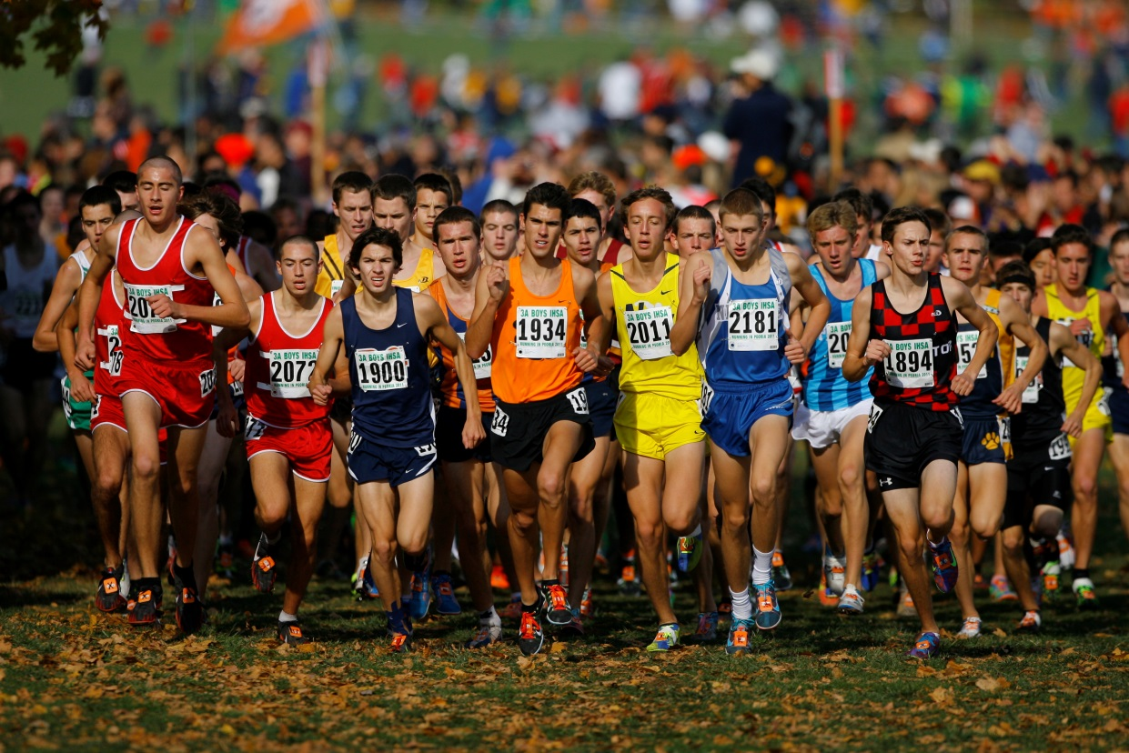
Cross country safety
Training for Cross Country is unique in that there are so many options afforded to the runner(s) to accomplish their workouts. Not being limited to the track allows the runners access to parks, city streets, and country roads.
Workouts and runs should be fun, relaxing, and carefree experiences.
The need for runner safety tips is evidenced by a dramatic increase in pedestrian deaths in the United States, as well as eight reported running-related motor vehicle crashes resulting in nine deaths and two disabling injuries among middle school and high school cross country and track and field runners between 2011 and 2021.
Cross Country runners share the road with vehicles and drivers that have become increasingly more distracted on the roads.
Notes:
Training for Cross Country is unique in that there are so many options afforded to the runner(s) to accomplish their workouts. Not being limited to the track allows the runners access to parks, city streets, highways and country roads.
However, each of these options creates safety concerns that all runners and coaches should keep in mind.
Workouts and runs should be fun, relaxing, carefree experiences.
The need for runner safety tips is evidenced by a dramatic increase in pedestrian deaths in the United States, as well as eight reported running-related motor vehicle crashes resulting in nine deaths and two disabling injuries among middle school and high school cross country and track and field runners between 2011 and 2021.
Cross Country runners share the road with vehicles and drivers that have become increasingly more distracted on the roads.

Slide 25
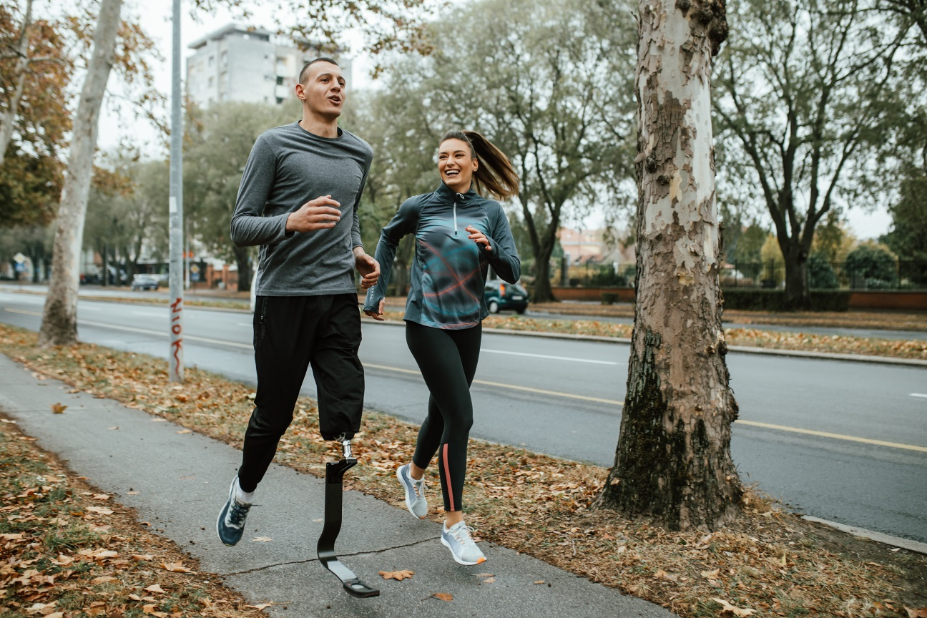
Cross country safety
Some key safety measures that can be promoted by school coaches and others to their Cross Country runners include:
Using sidewalks when available or run facing traffic.
Stay alert and avoid wearing headphones and using electronic devices, including cell phones.
Crossing roads at crosswalks and intersections, when available. If not, cross at a well-lit location.
Avoid running when it is dark. If it is dark, wear bright, reflective materials and/or use a flashlight or head lamp.
Notes:
It is critical that administrators, coaches and athletes promote and practice safety and risk minimization strategies as Cross Country runners share the road with vehicles and drivers that have become increasingly distracted on the roads.
Some key safety measures that can be promoted by school coaches and others to their Cross Country runners include:
Using sidewalks when available or run facing traffic.
Stay alert and avoid wearing headphones and using electronic devices, including cell phones.
Crossing roads at crosswalks and intersections, when available. If not, cross at a well-lit location.
Avoid running when it is dark. If it is dark, wear bright, reflective materials and/or use a flashlight or head lamp.
Follow the rules of the road.
Avoid running along eastbound roads at sunrise or along westbound roads at sunset.
Provide a safety orientation for first-year runners
Run in pairs
Never run against traffic lights
Avoid running in higher traffic speed areas
Run during lower traffic times if running along a road
Avoid loitering along the road before and after runs
Coaches need to plan when developing a road route where stop lights, routes, and heavy traffic exist.
Educating the athletes on where to go for safety in case of weather, emergency situations and hydration stops is crucial to athlete safety.

Slide 26

Cross country safety
Follow the rules of the road.
Avoid running along eastbound roads at sunrise or along westbound roads at sunset.
Provide a safety orientation for first-year runners
Run in pairs
Never run against traffic lights
Avoid running in higher traffic speed areas
Run during lower traffic times if running along a road
Avoid loitering along the road before and after runs
Notes:
It is critical that administrators, coaches and athletes promote and practice safety and risk minimization strategies as Cross Country runners share the road with vehicles and drivers that have become increasingly distracted on the roads.
Some key safety measures that can be promoted by school coaches and others to their Cross Country runners include:
Using sidewalks when available or run facing traffic.
Stay alert and avoid wearing headphones and using electronic devices, including cell phones.
Crossing roads at crosswalks and intersections, when available. If not, cross at a well-lit location.
Avoid running when it is dark. If it is dark, wear bright, reflective materials and/or use a flashlight or head lamp.
Follow the rules of the road.
Avoid running along eastbound roads at sunrise or along westbound roads at sunset.
Provide a safety orientation for first-year runners
Run in pairs
Never run against traffic lights
Avoid running in higher traffic speed areas
Run during lower traffic times if running along a road
Avoid loitering along the road before and after runs
Coaches need to plan when developing a road route where stop lights, routes, and heavy traffic exist.
Educating the athletes on where to go for safety in case of weather, emergency situations and hydration stops is crucial to athlete safety.

Slide 27
NFHS OFFICIALS Education

Slide 28





OFFICIALS EDUCATION
Content remains free of charge
TEACHING
AIDS
RULES
CHANGES
DIAGRAMS
VIDEO
LIBRARY
OFFICIALS
COURSES
Notes:
Sport-Specific Officiating courses are offered in several sports. They are ideal for new officials and those in the first few years of officiating. These courses introduce officials to the mechanics and techniques used in the sport and provide specific information on an area within that sport. Individuals can complete a course within 30-45 minutes. These courses are free to all officials and prospective officials.
“Interscholastic Officiating” is a general course on sports officiating, and it is free to all officials and prospective officials. This course provides an introduction to skills and concepts used as an official. Several topics are covered such as: basics of becoming and staying an official, science of officiating, art of officiating, how to combine these skills for successful officiating.
Video clips are made available to NFHS Officials Association members. The video is clipped on specific topics and provides the rules references as well as dialogue on the topic.
The courses and videos are offered at www.NFHSLearn.com .
Courses Available:
Officiating Football
Officiating Volleyball – Ball Handling
Officiating Volleyball – Alignment
Officiating Volleyball – E-Whistle
Officiating Basketball
Officiating Basketball – Three-Person Mechanics
Officiating Basketball - Pre-Game Conference
Soccer – Fouls and Misconduct
Soccer – Offside
Soccer - Pre-Game Conference
Swimming and Diving
Officiating Wrestling
Umpiring Softball
Officiating Field Hockey
Officiating Track and Field
Future Courses to be Considered:
Umpiring Baseball
Umpiring Softball – 2 Person Mechanics
Communication Among Officials and Coaches

Slide 29


Future Developments
Improved Schedule View
Year Two Accomplishments
Auto-Assign
Years of Service
14
121,508
$9.2M
Enhanced Payment Capabilities
States
Registering
Officials
Contests
Assigned
Payments
Sent to
Officials
100% FREE to your state as a NFHS-Member Benefit.
Notes:
NFHS CENTER FOR OFFICIALS SERVICES (COS)
Your Complete Solution for Officials Management and More:
Registration
Assignment
Payment
Testing
Background Checks
For More Information on the NFHS – Center for Officials Services (COS) Contact:
Dana Pappas, Director of Officiating Services, dpappas@nfhs.org
Also If You’re Interested in Eligibility and Monitoring Requirements Contact
the Folks at Dragonfly:
Kirk Miller, Dragonfly, kirk@dragonflyathletics.com
Brandon Wallace, Dragonfly, brandon@dragonflyathletics.com

Slide 30
NFHS Learning Center

Slide 31

Notes:
The NFHS Learning Center is the home to more than 90 online professional development courses for everyone within the interscholastic community - coaches, students, officials, parents, administrators, and individuals within performing arts programs. More than 60 courses are available for free.
The NFHS is an Accredited Institution and has delivered more than 15 million courses on its NFHS Learning Center platform since its inception in 2007. In receiving national accreditation by Cognia, the NFHS has upheld itself to rigorous standards that focus on productive learning environments, equitable resource allocation that meet the needs of learners, and effective leadership.
The NFHS Learning Center features its flagship coaching course, “Fundamentals of Coaching,” as well as several health and safety courses that have been completed by millions of individuals, such as “Concussion in Sports,” “Heat Illness Prevention,” “Sudden Cardiac Arrest” and “Protecting Students from Abuse.” The NFHS Learning Center offers several national credentials that can be earned by individuals who complete specific NFHS courses. Through the School Honor Roll Program, schools can earn a physical banner to hang in their school.
To learn more and start your professional development journey, please visit the NFHS Learning Center at NFHSLearn.com.

Slide 32
NFHS Network

Slide 33


NFHS Network
By 2025, every high school sporting event in America will be streamed live.
The NFHS Network will be
THE DESTINATION for fans
to view these broadcasts.
27 Different Sports and Activities
www.NFHSnetwork.com
Notes:
The NFHS Network is the leader in streaming Live and On Demand high school sports.
Partnered with the National Federation of State High School Associations, 45 high school state athletic/activities associations, and PlayOn! Sports, the NFHS Network is a joint venture created to provide fans with the ability to stream high school sports on any device, from wherever they are.
All NFHS Network events are available to watch online at www.NFHSnetwork.com and through the NFHS Network Live App for iOS and Android. Follow us on Facebook, Twitter, Instagram, and YouTube.
Watching high school sports and events has never been easier.
The NFHS Network’s goal to broadcast live all 2 million high school sporting events by 2025.
The NFHS Network covers 27 different regular season and postseason sports, as well as other high school activities, celebrating the accomplishments of students-athletes, student broadcasters, and high schools across the country.

Slide 34


Over 1 million events this year…
Notes:
The NFHS Network will broadcast over 150,000 live events this year. If your school is not a member of the NFHS Network School Broadcast Program, please contact us at Mark.Koski@NFHSnetwork.com

Slide 35
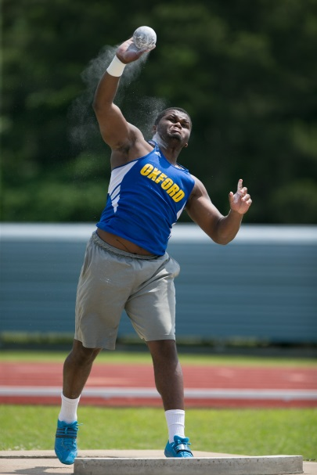
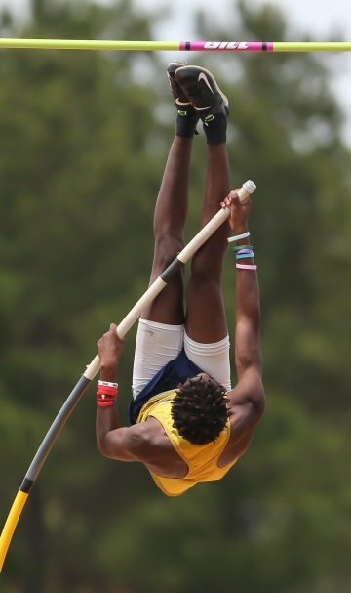
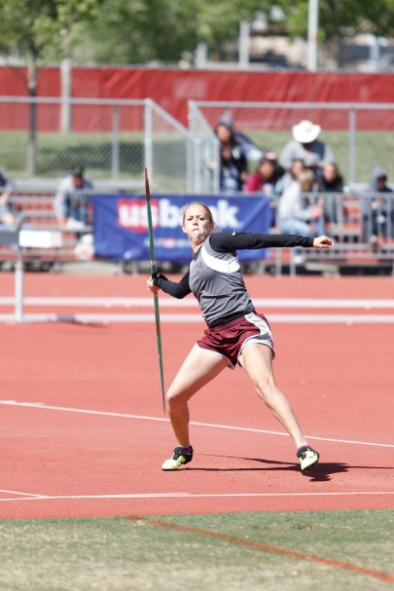
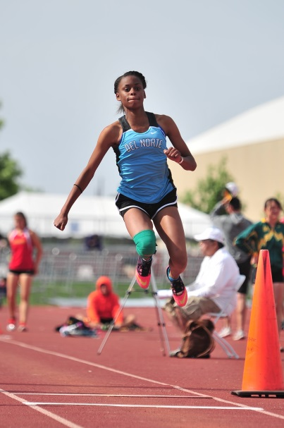
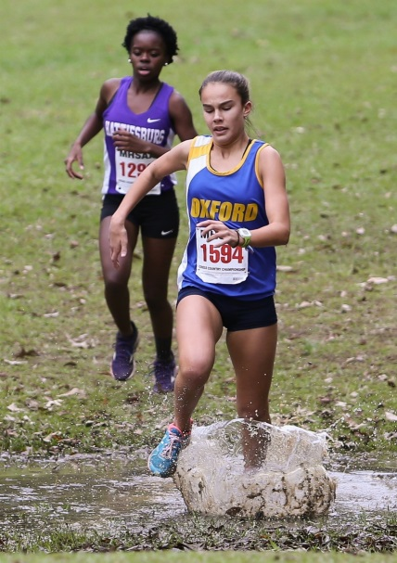
Thank You
National Federation of State High School Associations
PO Box 690 | Indianapolis, IN 46206
Phone: 317-972-6900 | Fax: 317.822.5700
www.nfhs.org | www.nfhslearn.com | www.nfhsnetwork.com

