Slide 1

Emergency Action Planning
Are you prepared?
Jeremy Haas, MS, LAT, ATC
Regional Director of Sports Medicine
Dignity Health Physical Therapy
Notes:
To use this title animation slide with a new image simply 1) move the top semi-transparent shape to the side, 2) delete placeholder image,
3) click on the picture icon to add a new picture, 4) Move semi-transparent shape back to original position, 5) Update text on slide.

Slide 2
“There’s no harm in hoping for the best as long as you’re prepared for the worst.”
—Stephen King, Different Seasons

Slide 3
Collaborative Solutions for Safety in Sport: A Call to Action to Ensure Best Practices are in Place in Secondary School Sports (2015)
Recommendations of Best Practices
  1. Create an emergency action plan in collaboration with coaches, athletic trainers, other medical professionals and local and campus safety officials.
  2. Have athletic trainers on staff: athletic trainers play a critical role in preventing sudden death in sport such as prevention, diagnosis, emergency care and treatment.
  3. Acquire and place automated external defibrillators (AEDs) on school campuses and at sporting facilities for immediate access in the case of a cardiac emergency.
  4. Ensure that athletes acclimatize progressively to training demands and environmental conditions for optimal safety. Conditioning should be phased in gradually: the first seven to 10 days of any new cycle should be considered transitional. Exercise and conditioning should not be used as punishment.

Slide 4
Create an Emergency Action Plan
1
2
3
4
5
EAP should be site specific, and include maps
EAP should be reviewed each season
EAP should be a written document distributed to all staff
Complete a readiness check before each athletic activity
Identify personnel and their responsibilities within designated chain of command
Reference : The basics you can find anywhere 5 Steps To Successful Storytelling Published on April 5, 2014 Featured in: Marketing & Advertising

Slide 5

1
EAP should be site specific, and include maps
  Cross streets of each field (may not always be the same)
  Which gate will EMS come through? Locks?
  Location specific details

Slide 6

2
EAP should be reviewed each season
PREPARE
“Take a walk”
Try to anticipate where you may have issues on campus
Get input from coaches and AT

Slide 7
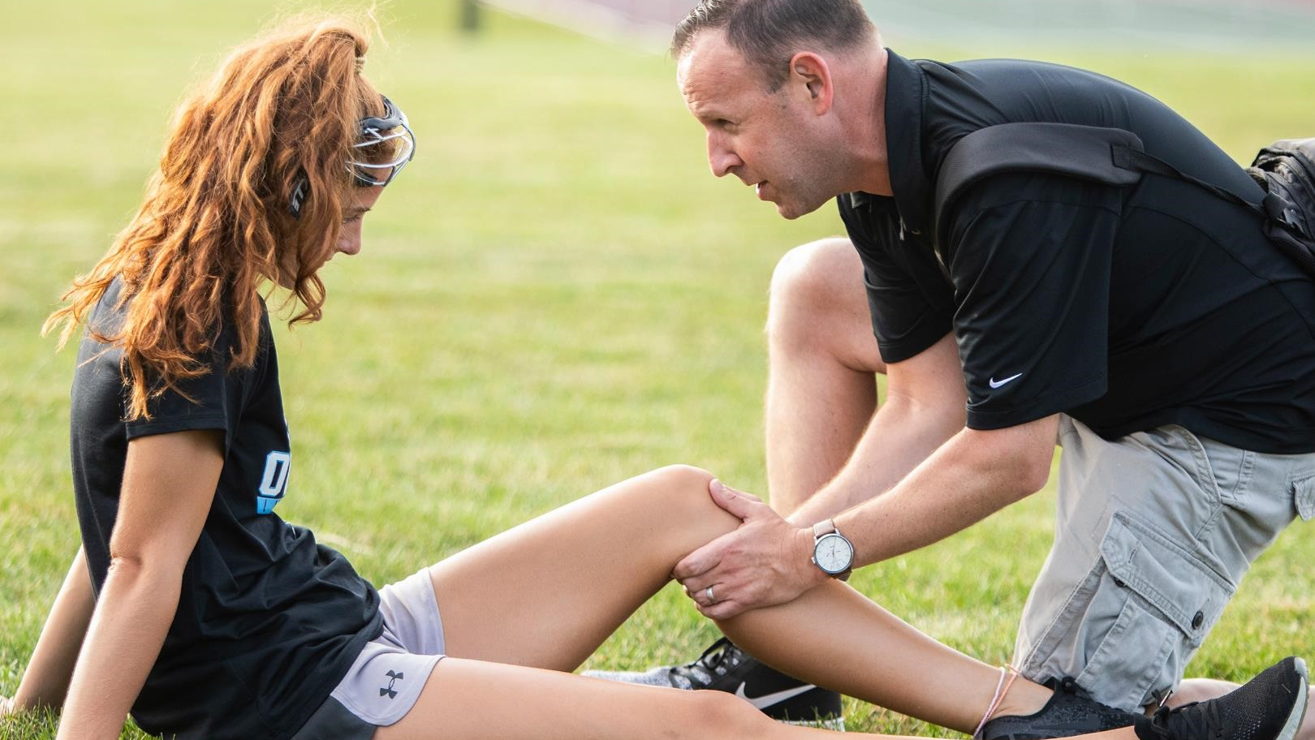
3
EAP should be a written document distributed to all staff
Notes:
Tip:
When using complex image as full-bleed background add a transparency (70%-90%) fill layer to give contrast to text.

Slide 8

4
Complete a readiness check before each athletic activity
    Does everyone know where the AEDs are located? Epi-pen?

Slide 9

5
Identify personnel and their responsibilities within designated chain of command
    Designate a “Call Leader”
    Does everyone know their role? Who is activating EMS? Who is calling the parents? Who is on crowd control? Who is meeting the ambulance outside the stadium/gym?

Slide 10
What worked? What didn’t?
Review
How can we best learn from our successes and mistakes?

Slide 11
Precedent has been set
Legal
Gathers v. Loyola Marymount Univ.
&
Kleinknecht v. Gettysburg College
“Need for organizations at all
levels that sponsor athletic activities to maintain an up-to-date,
thorough, and regularly rehearsed emergency plan”

Slide 12
“Administration and the sports medicine team have legal duty as professionals to ensure high quality care of participants”
Legal

Slide 13
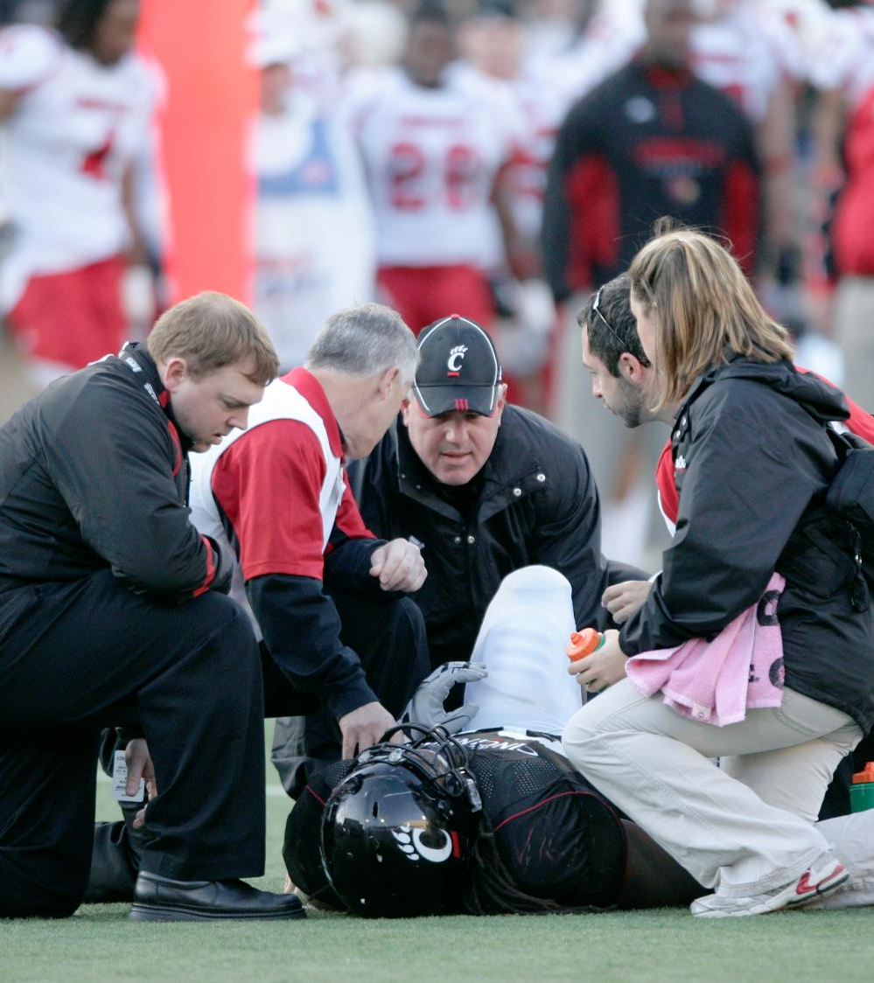
Recent Wrongful Death Lawsuits in HS
Matthew Mangine Jr. – soccer player in N.Ky
  Cardiac arrest
Imani Bell – basketball player in Atlanta
  Heatstroke during outdoor Basketball Practice
Allen Harris – football conditioning in Seattle
  Cardiac arrest
Drake Geiger – football player in Nebraska
  Hyperthermia
As well as many many more
link

Slide 14
Emergency Preparedness
Brain and Neck Injuries
Exertional Heat Stroke
Sudden Cardiac Arrest
Orthopedic Emergencies
Seizures
Anaphylaxis
Diabetic Emergencies
Stroke
Asthma
Exertional Sickling

Slide 15
TAKEAWAYS
        Be present
        Anticipate site specific issues
        Take a walk
        Readiness checks
        Write it down and document
        Ensure coaches are setting students up for success
        Take note of athletes with concerning medical Hx
        CPR and AED certifications
        Be aware that the emergency may not be an athlete
Notes:
Combine an image and multiple key statements with a strong grid.

Slide 16
“Administration and members of the sports medicine team have both legal and professional obligations to perform this duty to protect the interests of both the participating athletes and the organization or institution. At best, failure to do so will inevitably result in inefficient athlete care, whereas at worst, gross negligence and potential life-threatening ramifications for the injured athlete or organizational personnel are likely.”
Herbert DL. Legal Aspects of Sports Medicine. Canton, OH: Professional Reports Corp; 1990:160–167

Slide 17
Thank you

